Slide 1
Hackers Broke Into Real Sites to Plant Fake Stories
Andy Greenberg
Presented by:
Harveen Kaur
CS 795: Web Archiving Forensics
Department of Computer Science
Old Dominion University

Slide 2

Oxford Dictionary: A hacker is a person who uses computers to gain unauthorized access to data.
The word hacker dates back to thirteenth century England, earlier it only referred to someone who cut things roughly.
https://marketbusinessnews.com/financial-glossary/hacker/

Slide 3
Popularity of the internet
Why is the internet a popular source of information?
Fast
Variety of news sources
Videos and witness accounts
https://www.paypervids.com/is-the-internet-a-reliable-source-for-information/

Slide 4
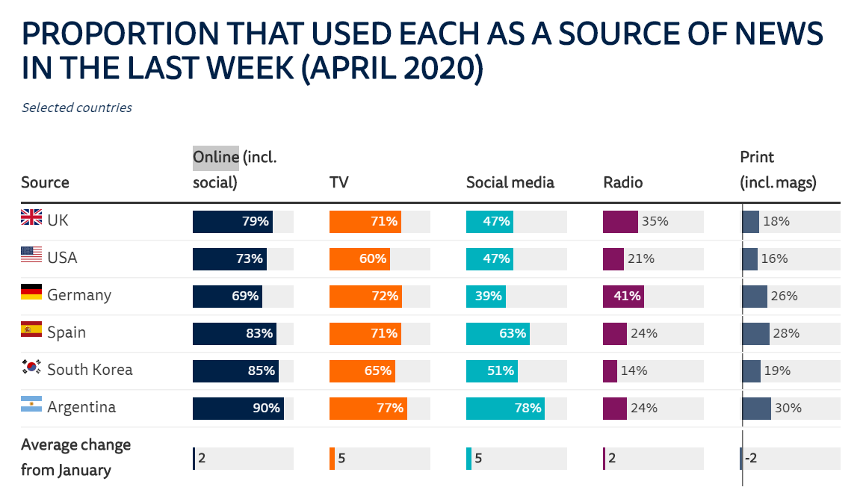
Digital News Report - University of Oxford
A survey conducted by the Reuters Institute for the study of journalism shows the news consumption trend in 6 different countries. (Initial study in January with a follow up in April.)
http://www.digitalnewsreport.org/survey/2020/overview-key-findings-2020/

Slide 5
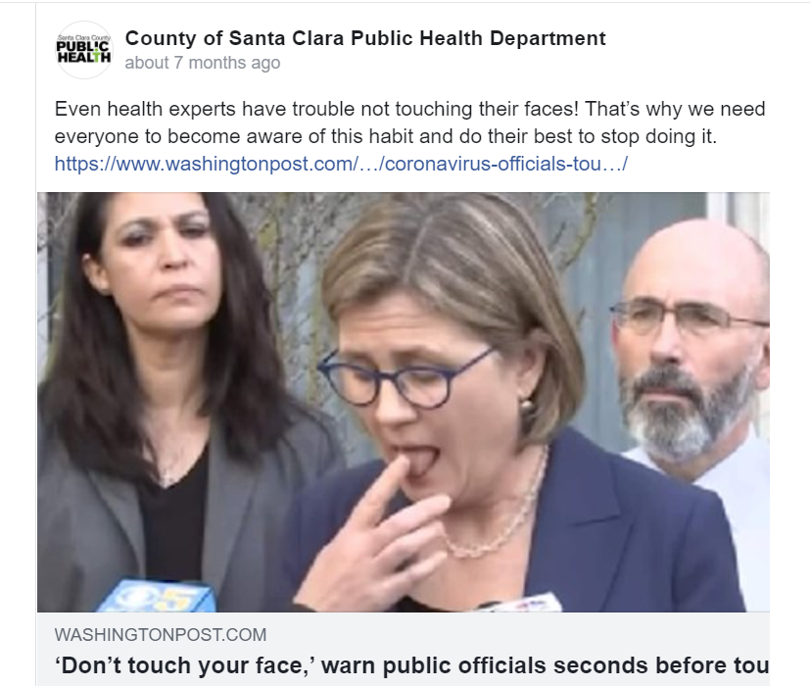
Newspaper Suffer
There is a decline in demand of traditional new source like newspaper because of the pandemic.
https://www.wgbh.org/news/commentary/2020/06/24/trust-is-down-digital-subscriptions-are-up-and-the-demand-for-objective-news-is-falling
Notes:
hello

Slide 6
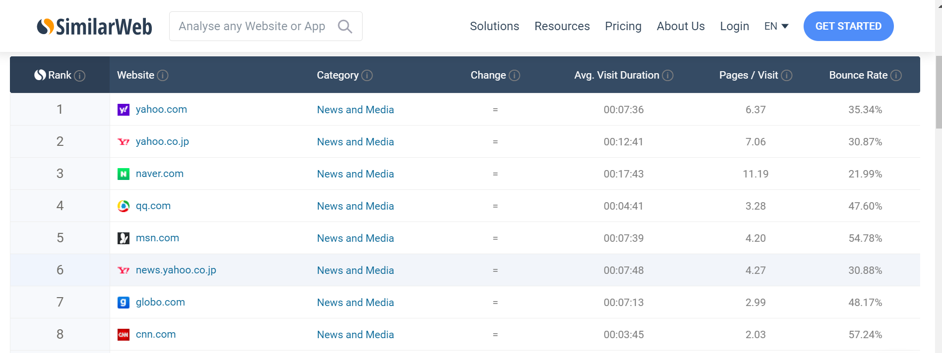
Most visited news website?
News sites are a popular source for information regarding national and international news.
One of the most famous news websites is yahoo.com with 175 million unique visitors each month.
https://www.techworm.net/2018/12/best-most-popular-news-websites-world.html https://www.similarweb.com/top-websites/category/news-and-media/
Percentage of visitors that viewed only one page of the website before exiting.
Average time spent by user per visit
Average time spent by user per visit

Slide 7
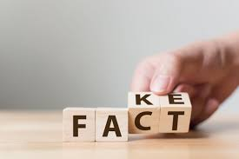
Disinformation vs. Misinformation
Disinformation: deliberately misleading or biased information; manipulated narrative or facts; propaganda.
Misinformation: false information that is spread, regardless of whether there is intent to mislead.
https://shawneesu.libguides.com/c.php?g=651556&p=7474715
https://www.dictionary.com/e/misinformation-vs-disinformation-get-informed-on-the-difference/

Slide 8
How is disinformation different from misinformation?
A word that can be used to distinguish between the two is “intent”.
Clearly, disinformation has the intent to harm.
https://www.dictionary.com/e/misinformation-vs-disinformation-get-informed-on-the-difference/

Slide 9
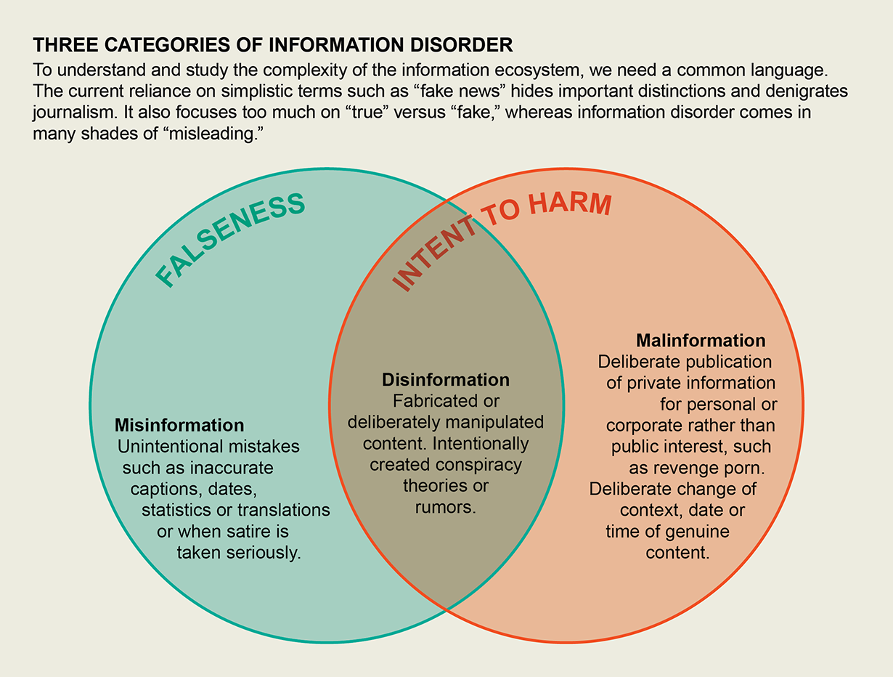
Categories of information disorder
“Disinformation can turn into misinformation when people share disinformation without realizing it is false.”
https://www.scientificamerican.com/article/misinformation-has-created-a-new-world-disorder/

Slide 10
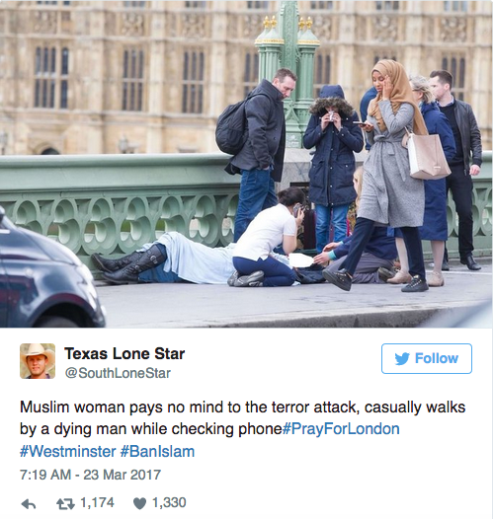
Pictures can be misleading
In the aftermath of the Westminster attack of 2017, an image of a Muslim women walking by a victim went viral and recieved criticism.
Six people died and 50 others were injured in the attack.
The post was made to stoke islamophobic sentiments. https://au.finance.yahoo.com/news/westminster-bridge-woman-breaks-silence-000955558.html
https://www.theguardian.com/uk-news/2017/nov/14/how-a-russian-troll-soldier-stirred-anger-after-the-westminster-attack
Does not exist

Slide 11

What is the agenda?
-spread fake news
-provoke extremist sentiment
-political influence
-seed distrust
-cause confusion
https://crestresearch.ac.uk/projects/disinformation-on-social-media/

Slide 12
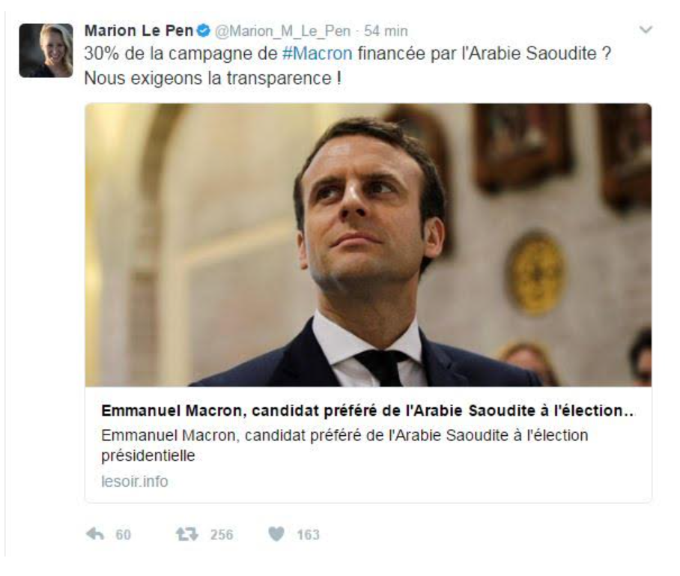
Marion Le Pen tweeted
"30% of Macron's campaign funded by Saudi Arabia? We demand transparency"
Marion Le Pen tweeted (niece of National Front presidential candidate[2017] Marine Le Pen)
a story from LeSoir.info.
https://www.bbc.com/news/world-europe-39265777

Slide 13
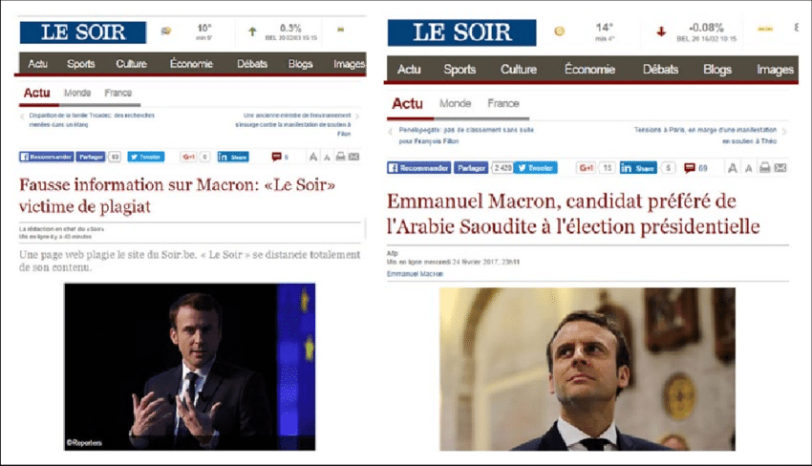
Real vs. Fake site
The actual site lesoir.be
Fake site lesoir.info

Slide 14
Disinformation
So, we can clearly see the intent of creating this very convincing replica of Le Soir site was to spread disinformation.
This was spread over facebook and generated around 10,000 likes, shared and comments on facebook.
https://www.bbc.com/news/world-europe-39265777

Slide 15
What does the article talk about?
In recent times, a lot of legitimate European new sites have been hacked, the purpose was to add fake stories and spread these stories all over the internet.
How?
By hacking the content management system of these sites.
By using an ex-employee’s credentials.
https://www.wired.com/story/hackers-broke-into-real-news-sites-to-plant-fake-stories-anti-nato/

Slide 16
Ghostwriter
“The term Ghostwriter is defined as a professional writer who is employed to write works for which he will receive no official credit but will instead remain anonymous.”
Ghostwriter Campaign- Since 2017, mainly targeted Lithuania, Latvia and Poland.
Instigate distrust of US and NATO (North Atlantic Treaty Organization) troops.
https://blog.scielo.org/en/2014/01/16/ethical-editing-ghostwriting-is-an-unhealthy-practice/#.X3EGq2hKg2w

Slide 17
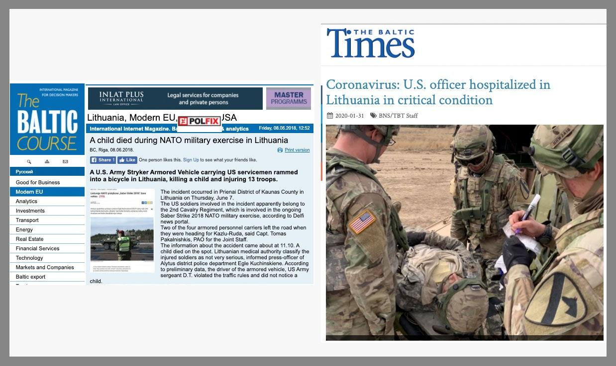
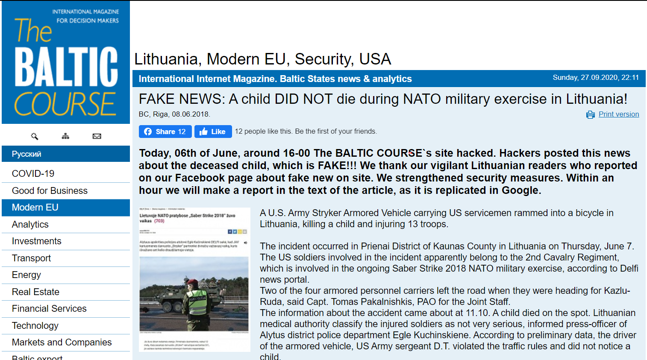
Fake News
Fake news posted on The Baltics Course and Baltic Times.
http://www.baltic-course.com/eng/modern_eu/?doc=140643
https://www.wired.com/story/hackers-broke-into-real-news-sites-to-plant-fake-stories-anti-nato/

Slide 18
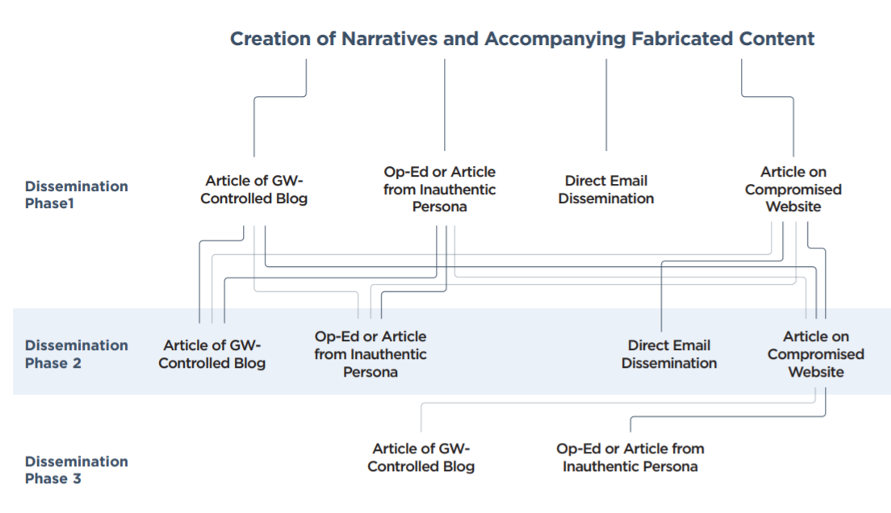
Flow of dissemination
https://www.fireeye.com/content/dam/fireeye-www/blog/pdfs/Ghostwriter-Influence-Campaign.pdf

Slide 19



Where these articles are published?
Such articles are generally published on sites that allow submission of user generated content.
https://www.opednews.com/
https://theduran.com/
http://balticworlds.com/
https://www.fireeye.com/content/dam/fireeye-www/blog/pdfs/Ghostwriter-Influence-Campaign.pdf

Slide 20
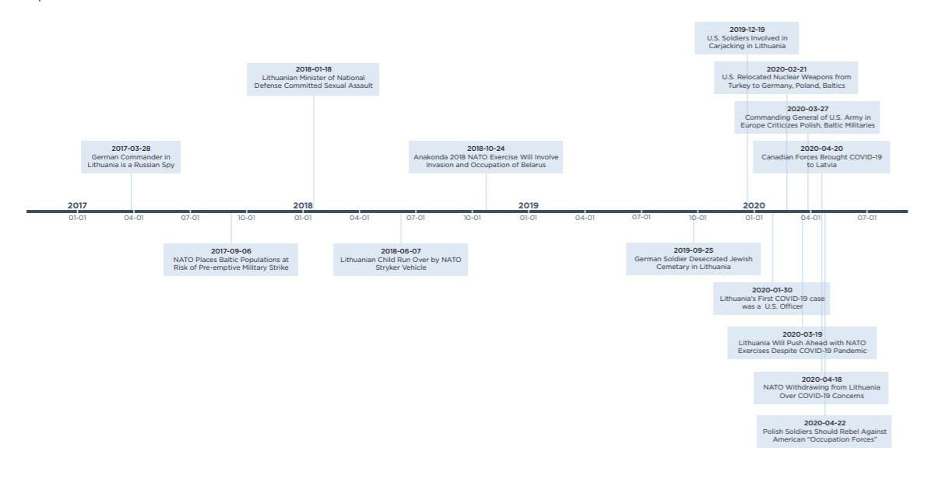
Operational Timeline
https://www.fireeye.com/content/dam/fireeye-www/blog/pdfs/Ghostwriter-Influence-Campaign.pdf

Slide 21
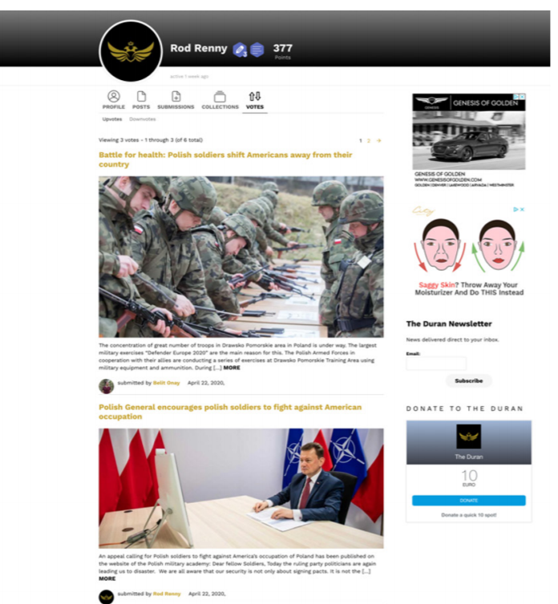
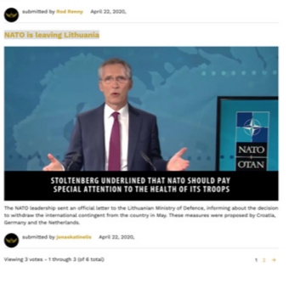
Ghostwriter Persona
-inauthentic
-posers
-posts fabricated material on
websites that allow user generated
content
https://www.fireeye.com/content/dam/fireeye-www/blog/pdfs/Ghostwriter-Influence-Campaign.pdf
Fake information

Slide 22
Fake stories on real sites
-Fake stories are published on legitimate sites
-Spread over the internet
According to Fireeye- “The spread doesn’t seem to be financially motivated, rather indicates to political or state backer and the motive being causing distrust among European citizens regarding NATO.”
https://www.fireeye.com/content/dam/fireeye-www/blog/pdfs/Ghostwriter-Influence-Campaign.pdf

Slide 23
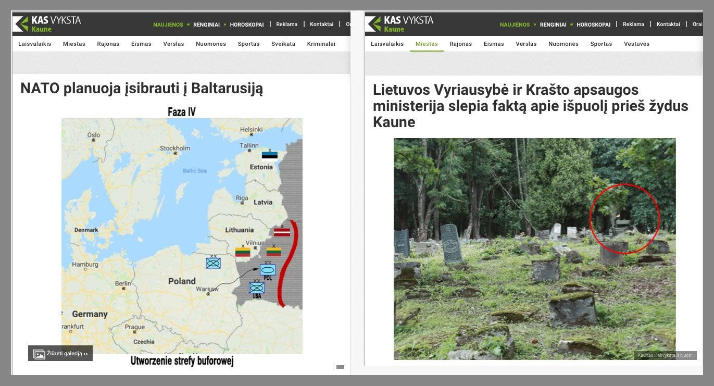
Local News Site- Fake News
-Local site
-Hacked in October 2018
-NATO plans to attack Belarus
-Hacked in September 2018
-Jewish cemetery desecrated
https://www.wired.com/story/hackers-broke-into-real-news-sites-to-plant-fake-stories-anti-nato/

Slide 24
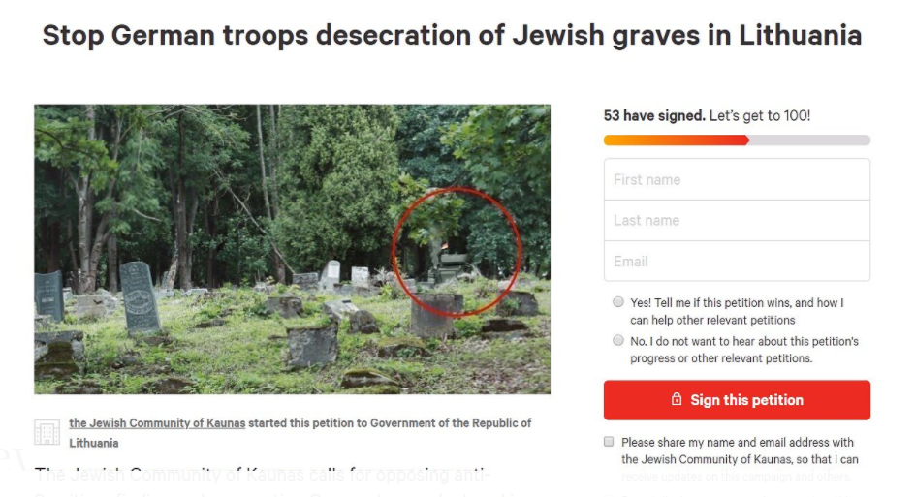
Impact of the news
Immediately, after the news was posted a petition was started on change.org.
https://www.lrt.lt/en/news-in-english/19/1101632/more-fake-news-target-nato-s-presence-in-lithuania

Slide 25

How information spreads cross platform
Information spreads cross platform
Memes
Videos
Social posts
https://www.scientificamerican.com/article/misinformation-has-created-a-new-world-disorder/

Slide 26
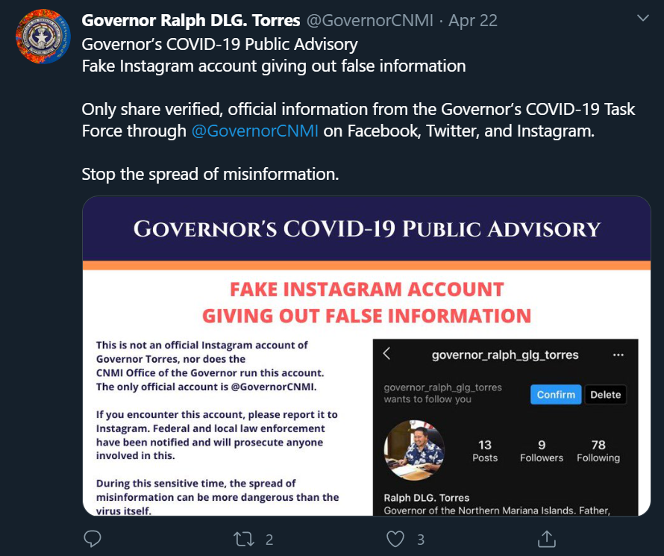
Misinformation can be spread anywhere
-American politician
-April 2020
-false information
-fake account
https://twitter.com/GovernorCNMI
Tweet by Governor Ralph DLG Torres

Slide 27
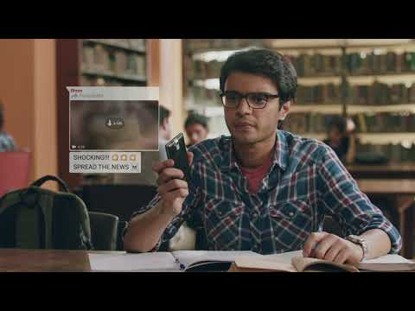
Whatsapp forced to warn users in India
https://www.youtube.com/watch?v=t_gmgnOpA98&t=1s

Slide 28
Misinformation leads to mob killing
In an incident in 2018, a misinformed group of people in a village believed that a group of visitors were involved in child kidnapping
This lead to mob lynching and the death of one of the visitors
In 2018- at least 12 people died because of rumors spread on whatsapp
https://www.washingtonpost.com/politics/2020/02/21/how-misinformation-whatsapp-led-deathly-mob-lynching-india/

Slide 29
Part of Solution
“Misinformation is not like a plumbing problem you fix. It is a social condition, like crime, that you must constantly monitor and adjust to.”-Tom Rosentie
We, as users should be more aware and careful about what we are sharing over the internet.
-think before sharing information
-be calm
-to be informed about disinformation and misinformation
https://www.pewresearch.org/internet/2017/10/19/the-future-of-truth-and-misinformation-online/
https://www.scientificamerican.com/article/misinformation-has-created-a-new-world-disorder/

Slide 30
Conclusion
We can see both disinformation and misinformation are contributors of fake news on the internet.
The vulnerabilities of the internet can be exploited and weaponized to cause harm
Instigate hate
In politics
Cause panic

